Slide 1
Project Title: PLANT HEALTH MONITORING AND AUTOMATED PLANT WATERING SYSTEM
Course Teacher: Tahseen Asma Meem
Lecturer
Department of Electrical and Electronic Engineering
SL # | Students ID | Students Name | Program
1 | 21-44498-1 | Md. Shahriar Mahmud | CSE
2 | 21-44401-1 | Israk Hossain Pantho | CSE
3 | 21-44747-1 | Md Ismail Jobi Ullah | CSE
4 | 20-43866-2 | Sadman Sanid Tanim | CSE
5 | 20-41964-1 | Md Shakib Khan | CSE

Slide 2

Outline of the Presentation
Introduction
Literature Review
Methodology and Modeling
Results and Discussions
Conclusion and Future Endeavors

Slide 3

Introduction
Background
Right Amount of Water
Plants Wilting, Drying Out, Dying
Waste of Electricity and Water
Automated Plant Watering System
Notes:
Having the right amount of water is super important for plants. For this reason, timely watering is essential for plant health.
But over watering is a bad things for plants. Because of this, we can see plants wilting, drying out and even dying.
Overwatering is not only dangerous for plant health but also causes electricity and water waste.
To solve this issue, we created an Arduino based automated plant water system. And this system can be used to monitor plant health also.

Slide 4
Introduction
Objectives
Implementing an Automated Plant Watering System
Developing a Monitoring System
Creating Algorithm
Evaluating The System's Performance
Promoting Awareness of Plant Care using Technology
Notes:
We will implement an Arduino UNO for this system, which will collect data from the environment through sensors and automate the watering process.
There will be a monitoring system that will monitor soil moisture, temperature, and humidity. An algorithm will be developed that will make decisions about when motors will be started and stopped.
There will be an evaluation session. In that session, we will test this system and evaluate its performance. If it performs well, then it will be considered a successful project.
There is an intention to promote awareness of plant care. We will show people how technology can solve plant health-related issues. And we will encourage them to adapt new technology to solve plant health-related issues.

Slide 5
Literature Review
Testing of Nine Orchards to Develop Automatic Irrigation Scheduling Systems
A Survey that Covers Soil and Weather Monitoring
Reduction of 11% Water Wastage
Plant Watering System Utilizing a Microcontroller and Moisture Sensors
IOT in Water Distribution Systems
Notes:
Nine orchards were tested during 2018 using linear regression (LR), random forest regression (RFR), and support vector regression (SVR) methods. The results obtained lead to the conclusion that these methods are valid engines to develop automatic irrigation scheduling systems [1].
A survey is done to focus on smart irrigation systems in water-scarce regions. It covers soil and weather monitoring, communication technologies, data management, low-cost sensors, sustainable practices, and future challenges, offering insights into efficient water usage and agriculture optimization [2].
The water monitoring system improved water sustainability and reduced the daily water use of a beverage factory by 11%. Unfortunately, due to poor management, loss of climate control, and overuse of water, there can be heavy losses of up to 40% for crops grown in greenhouses. The Arduino microcontroller system has proven to be reliable when installed in large greenhouses and the system saves approximately 12.5% of the water normally used in these greenhouses. Additionally, the linear model was chosen as the best model to use in greenhouses, with the average accuracy percentage simulation and mean square error being 92.038 and 0.01988%, respectively [3].
The abstract introduces an automated plant watering system that utilizes a microcontroller and moisture sensors to regulate watering based on soil moisture levels, aiming to simplify plant care and enhance water efficiency. The system's components, methodology, and benefits, including water conservation and adaptability, are discussed in detail [4].
There is a paper that presented a detailed, up-to-date review of the state-of-the-art role of IoT in water distribution systems. It presented the taxonomy of the water distribution system and role of IoT technologies, architectures, cloud platforms in various water distribution applications. It proposed an IoT architecture for intelligent water networks: IoTA4IWNet, for real-time monitoring which is relevant to our project [5].

Slide 6
Methodology and Modeling
Components
Micro JST 1.25mm 2-Pin Male to Female connector (Quantity: 2)
Jumper Wires (M to F) 20 Pieces (Quantity: 1)
Jumper Wires (M to M) 20 Pieces (Quantity: 3)
12V 5A Power Adapter (Quantity: 1)
2.1mm Barrel Type Female DC Power Jack (Quantity: 1)
1 Channel Relay (5V) (Quantity: 2)
Breadboard (Quantity: 1)
LCD Display (20 x 4) with Header (Quantity: 1)
Solar Water Pump (Quantity: 2)
Waterproof DS18B20 Digital Temperature Sensor (Quantity: 1)
Soil Moisture Sensor (Quantity: 2)
DHT22 Temperature and Humidity Sensor (Quantity: 1)
Arduino UNO R3 (Quantity: 1)

Slide 7
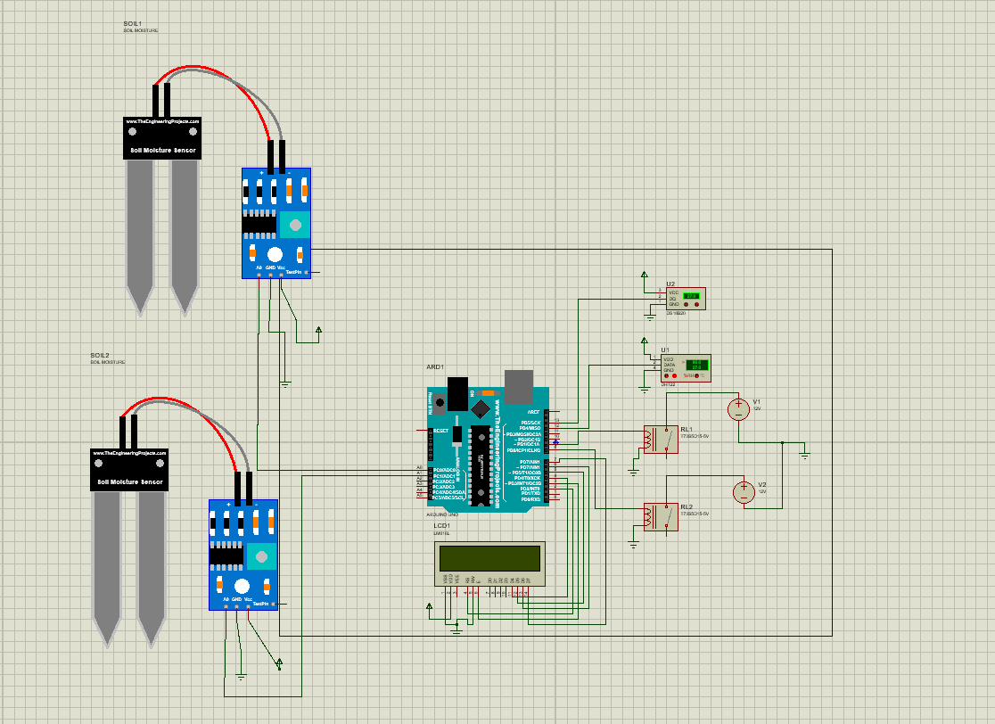
Methodology and Modeling
Circuit Diagram

Slide 8
Methodology and Modeling
Code
Library function :
#include <DHT.h>
#include <OneWire.h>
#include <DallasTemperature.h>
#include <LiquidCrystal.h>
Pin Selections:
int waterpump1 = 8; //pump relay pin
int waterpump2 = 9;
#define ONE_WIRE_BUS 12 // Pin connected to DS18B20 data pin
#define DHTPIN 13
#define SOIL_MOISTURE_PIN_1 A0
#define SOIL_MOISTURE_PIN_2 A1

Slide 9
Methodology and Modeling
Code
void setup() {
Serial.begin(9600);
sensors.begin();
dht.begin();
pinMode(waterpump1, OUTPUT);
pinMode(waterpump2, OUTPUT);
// Set up the number of columns and rows on the LCD
lcd.begin(20, 4);
// Print a message on the LCD
lcd.setCursor(0,0);
lcd.print("Plant Monitor System ");
}

Slide 10
Methodology and Modeling
Code
void loop() {
float temperature = dht.readTemperature();
float humidity = dht.readHumidity();
sensors.requestTemperatures();
int soilMoisture1 = analogRead(SOIL_MOISTURE_PIN_1);
int soilMoisture2 = analogRead(SOIL_MOISTURE_PIN_2);
int soilMoisture1Real = map(soilMoisture1, 1023, 0, 0, 100);
int soilMoisture2Real = map(soilMoisture2, 1023, 0, 0, 100);
float waterTemperatureC = sensors.getTempCByIndex(0);

Slide 11
Methodology and Modeling
Code
if ((soilMoisture1Real < 40) && ((15 > waterTemperatureC) || ( waterTemperatureC<25)) ) //Vegetables
{
digitalWrite(waterpump1, LOW); Serial.println("Pump 1 On");
}else{
digitalWrite(waterpump1, HIGH); Serial.println("Pump 1 Off");
}
if (soilMoisture2Real < 30 && ((18 > waterTemperatureC) || ( waterTemperatureC<25))) //Houseplants
{
digitalWrite(waterpump2,LOW ); Serial.println("Pump 2 On");
}else{
digitalWrite(waterpump2,HIGH ); Serial.println("Pump 2 Off");
}
delay(1000); // Adjust the delay as needed
}

Slide 12
Results and Discussions
Standard Data of Plant
Plant | Soil Moisturizer (%) | Temperature (degree Celsius) | Humidity (%) | Water Temperature (degree Celsius)
Tomato | 41 | 20-30 | 50-70 | 15-25
Aloe vera | 31 | 18-27 | 30-50 | 18-25
Motor 1: Tomato
Motor 2: Aloe vera
Soil Moisture (%) | Water Temperature | Motor number | Status
60 | 25 | Motor 1 | Off
60 | 25 | Motor 2 | Off
45 | 25 | Motor 1 | Off
45 | 25 | Motor 2 | Off
40 | 25 | Motor 1 | On
40 | 25 | Motor 2 | Off

Slide 13
Results and Discussions
Standard Data of Plant
Provide Information About Ideal Conditions for Growing Tomato and Aloe Vera Plants.
Highlight Key Factors Affecting Plant Growth: Soil Moisturizer, Temperature, Humidity, and Water Temperature.
Assist Cultivators in Creating Optimal Environments for These Plants to Thrive.
Maximize Plant Health and Growth by Following Recommended Guidelines.

Slide 14
Results and Discussions
PLANT STATUS
Monitor and control irrigation for Tomato and Aloe Vera plants using two motors (Motor 1 and Motor 2).
Track soil moisture percentage and water temperature as key parameters for irrigation decisions.
Ensure optimal watering conditions for each plant type.
Maintain suitable soil moisture levels to support plant growth.
Implement automated on/off status for motors based on plant-specific requirements.
Improve plant health by providing appropriate irrigation tailored to individual plant needs.

Slide 15
Results and Discussions
Cost Analysis
Total Cost: 4650.33 BDT
Final Cost (Including Discounts and Shipping): 4514.14 BDT

Slide 16
Results and Discussions
Limitations
Automated plant watering system offers valuable solutions for plant care challenges.
Limitations include lack of remote functionality for watering and sensor data monitoring.
Absence of remote features restricts user convenience and accessibility.
System lacks a mobile or computer interface for enhanced user interaction.
Addition of a user-friendly application could empower effective plant care management.
Identified limitations highlight potential for refining and expanding system capabilities to better serve user needs.

Slide 17
Conclusion and Future Endeavors
Significance: Addresses Plant Care and Irrigation Challenges through Automation.
Components: Integrates Environmental Sensors, Decision Algorithms, and Automation Mechanisms.
Potential: Optimizes Watering Practices and Improves Overall Plant Health.
Benefits: Enhances Efficiency and Reduces Manual Intervention.
Limitations:
Lack of Remote Functionality: Hinders Control and Monitoring From a Distance.
Absence of User Interface: Limits Usability and User Interaction.
Future Directions: Consider Adding Remote Access and User-friendly Interface Features.

Slide 18
Conclusion and Future Endeavors
Future Endeavors
Remote Connectivity
User-Friendly Interface
Data Analytics
Integration of IoT
Energy Efficiency

Slide 19
Thank You

